Slide 1

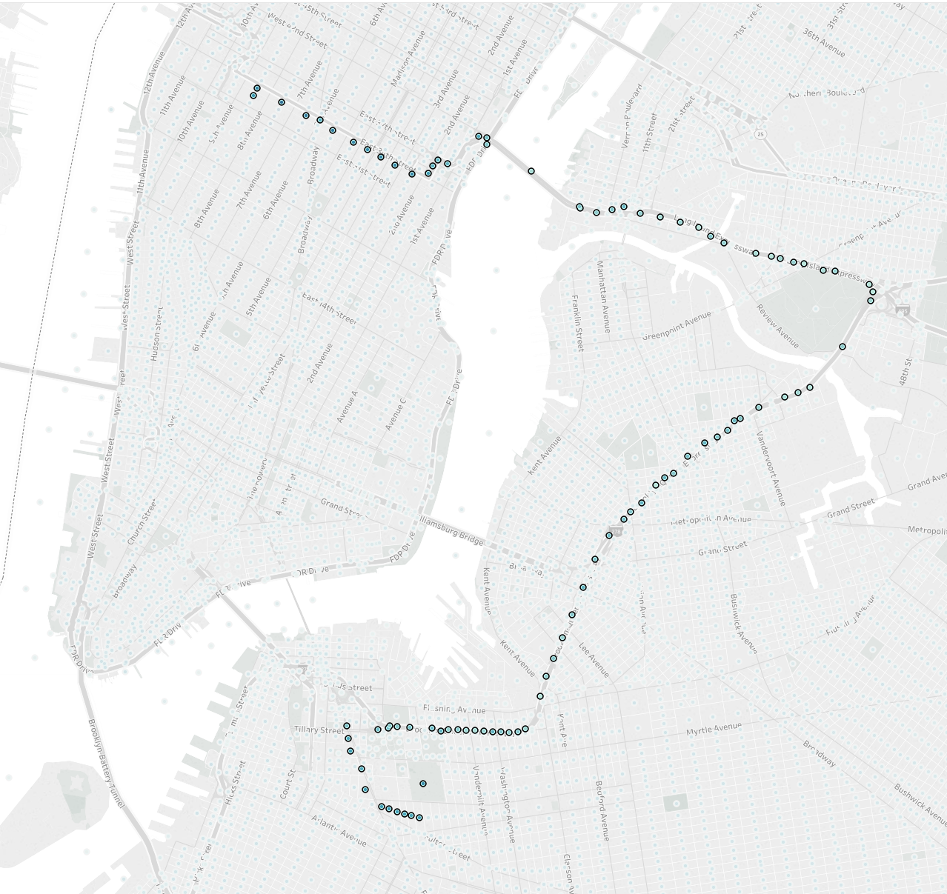
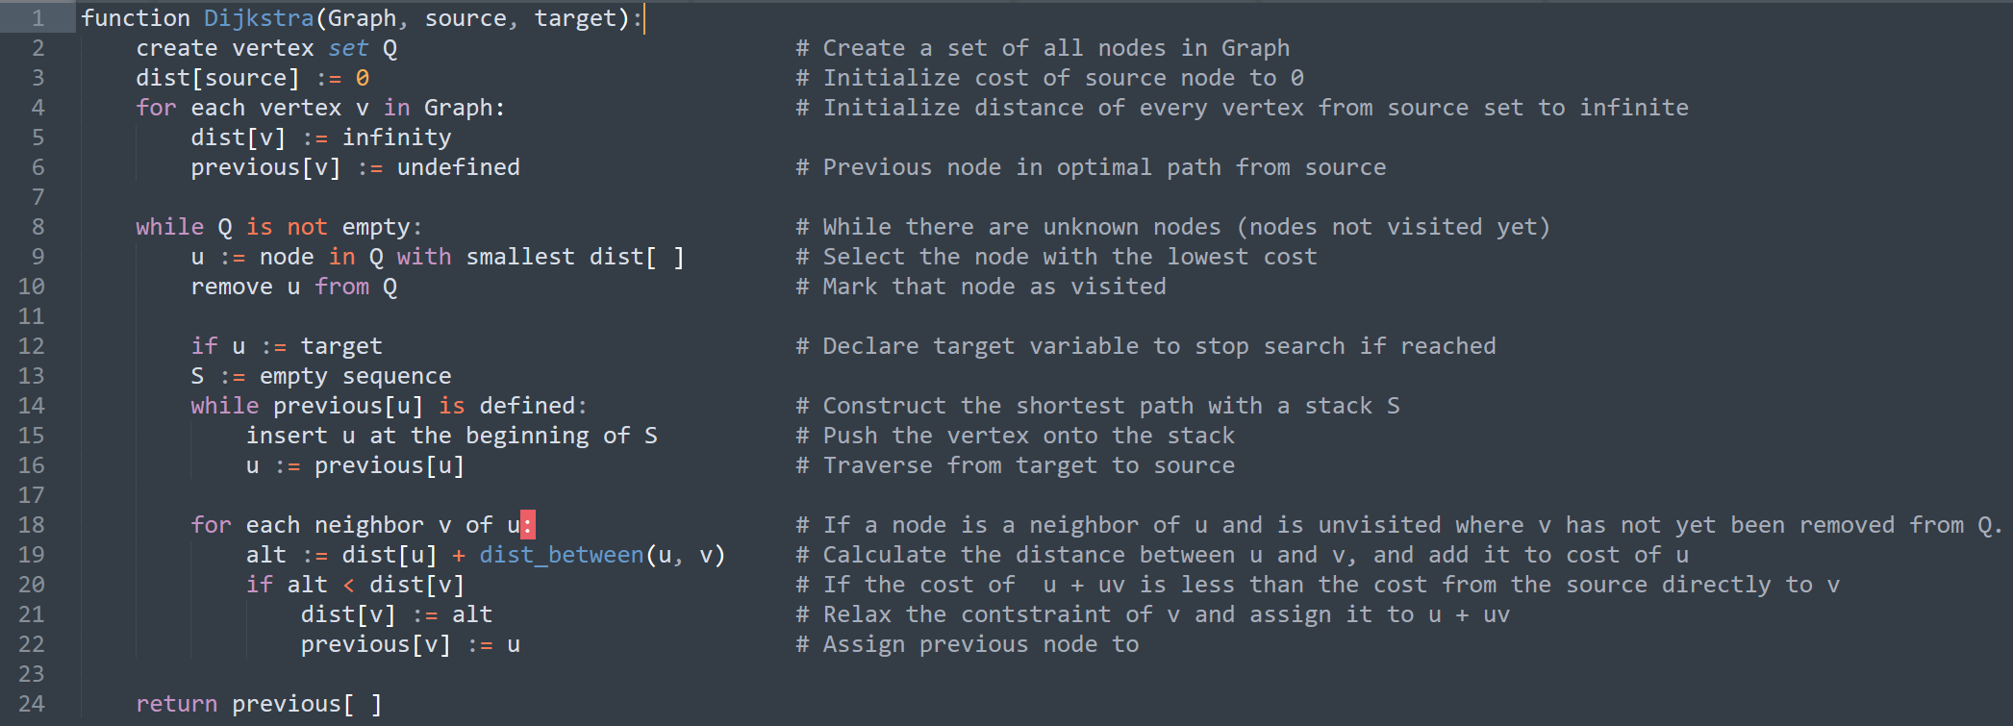
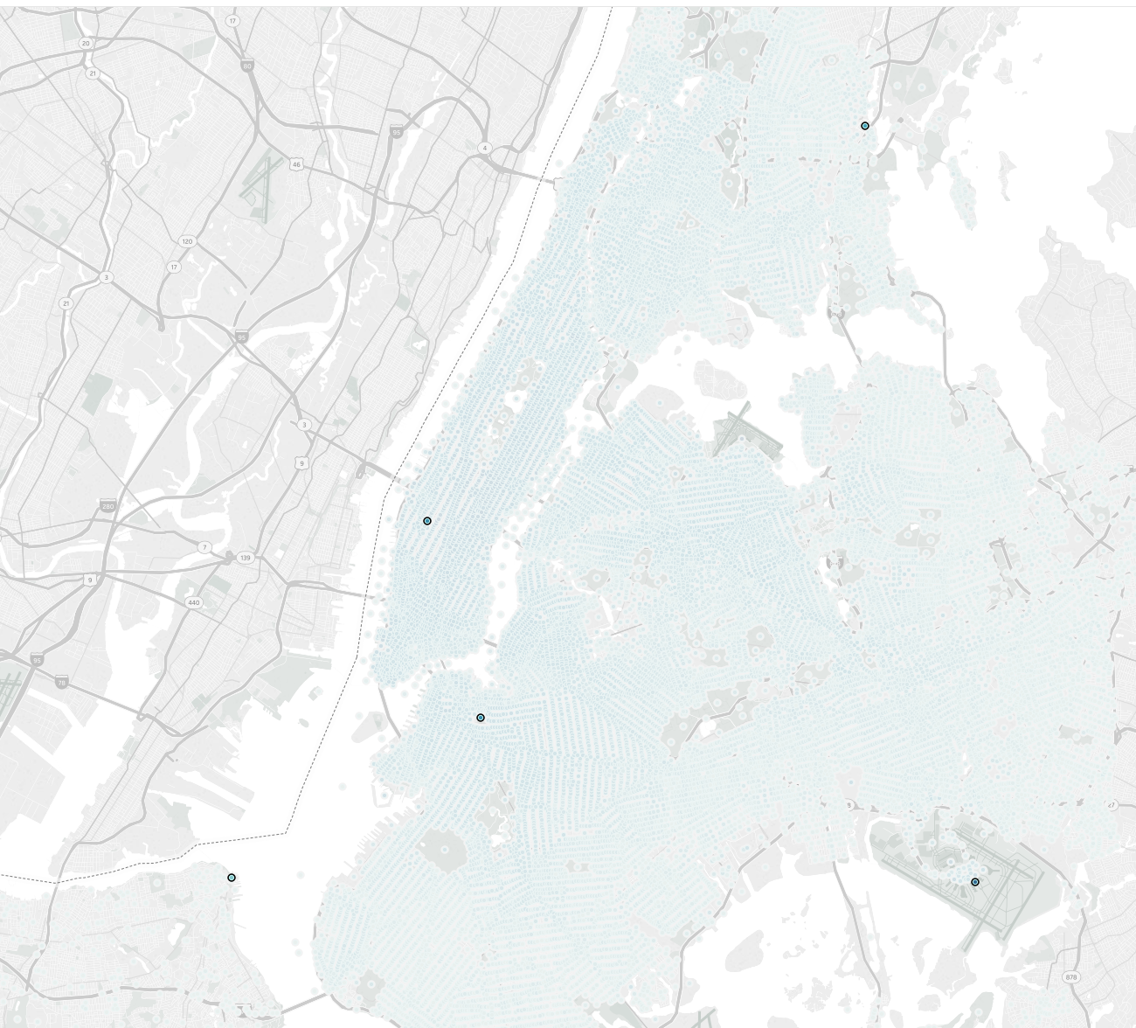
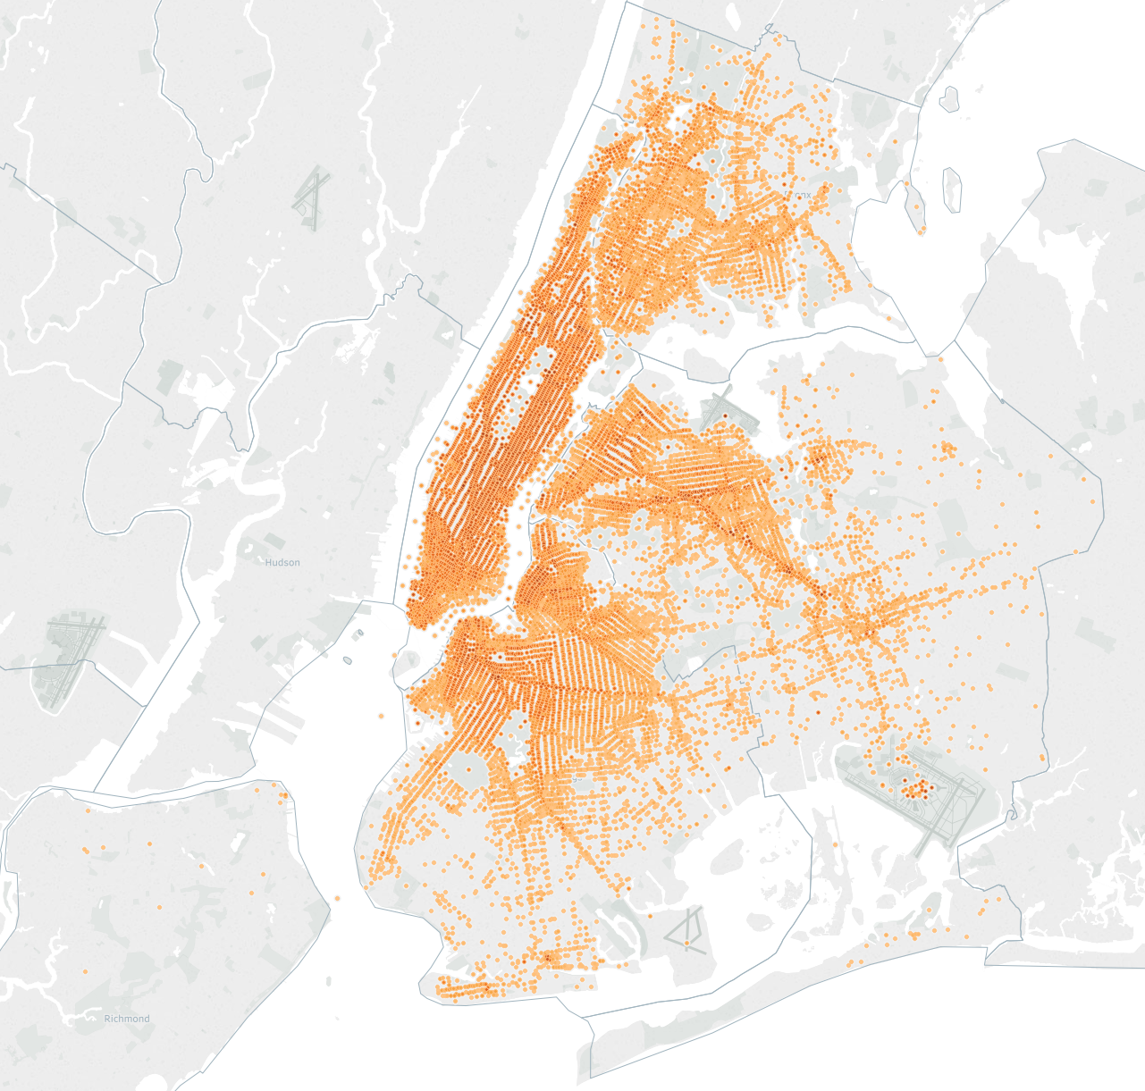
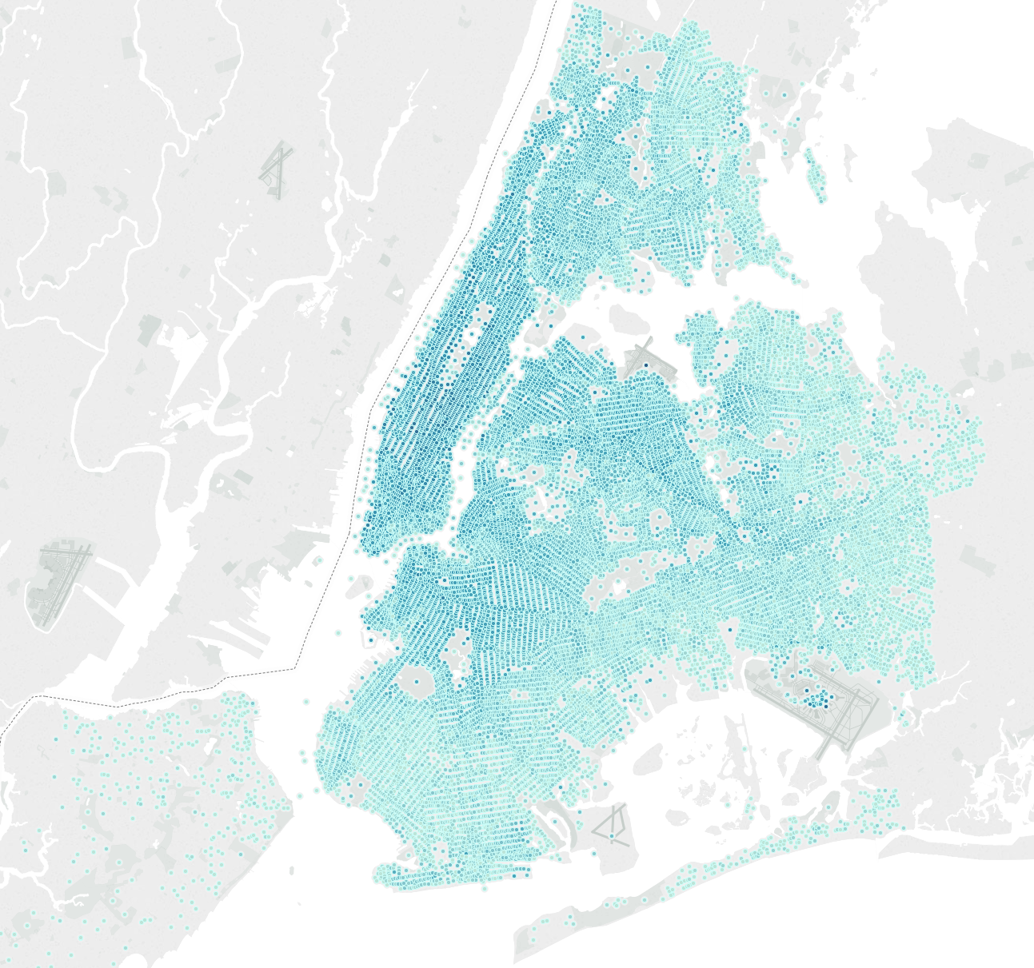
Vehicle Routing Problem using NYC TLC Data Adarsh Alok, Garvita Malhan, Ephraim Schoenbrun, Abhir Yadava Instructor: Alkis Vazacopoulos
Business Intelligence & Analytics
Introduction
Vehicle Routing Problems (VRP) are combinatorial optimization problems used in the fields of transportation, distribution and logistics to minimize the cost of travel and maximize its utility
Purpose: Solving this optimization problem can assist with resource planning, cost mapping, and logistical efficiency. Even small improvements in the performance of the supply chain may lead to notable financial and ecological benefits and competitive advantages
Problem Statement:
Most VRP use distance as a weight to calculate the shortest route between nodes. However, in densely populated areas like NYC, distance does not necessarily represent the minimization in an entity’s transportation cost. Time is a better metric to reflect its costs and benefits
Process:
Use granular TLC trip data to populate a large-scale network
Calculate the shortest path between two destinations by aggregating the values of the weights of the shortest path
Use the new weights to build a high-level graph and run several VRP algorithms to determine the optimal sequence of stops
Shortest Path
Dijkstra’s Algorithm is a greedy algorithm that efficiently solve a Single Source – Single Destination problem in a weighed, directed graph by iteratively updating vertices if a lower cost node is discovered in a breadth first search
By calculating the shortest path between each of our destinations, we can construct a matrix to solve the vehicle routing problem
Vehicle Routing Problem
Data Understanding and Wrangling
1.1 Billion trips
Pick-up Locations Drop-off Locations
Random Sampling: To reduce the size of the data, we sampled two million trips between 2014-2015
Aggregating: We centered each pick-up and drop-off point to its corresponding city block. This allows us to take the mean time of duplicitous trips with slightly different coordinates, further reducing the size of the data and increasing the robustness
There are many metaheuristic algorithms that can solve the traveling salesperson problems and vehicle routing problems like ant colony optimization and particle swarm optimization. We utilized Google’s OR tools, which implements a local search with randomization, similar to simulated annealing and tabu search.
BPM
5
4
MSG
3
1
ATL
2
SIF
(Deopt)
JFK
Findings
Optimal shortest paths were not always better than google maps time estimates. However, it did not take into account times of day, where certain edge’s weights would be significantly less
Future Work
Calculate weights dependent on time to determine order
Multiple Vehicles, Time Windows, Capacitated, Stochastic demand
http://www.stevens.edu/howe/academics/graduate/business-intelligence-analytics

